Slide 1
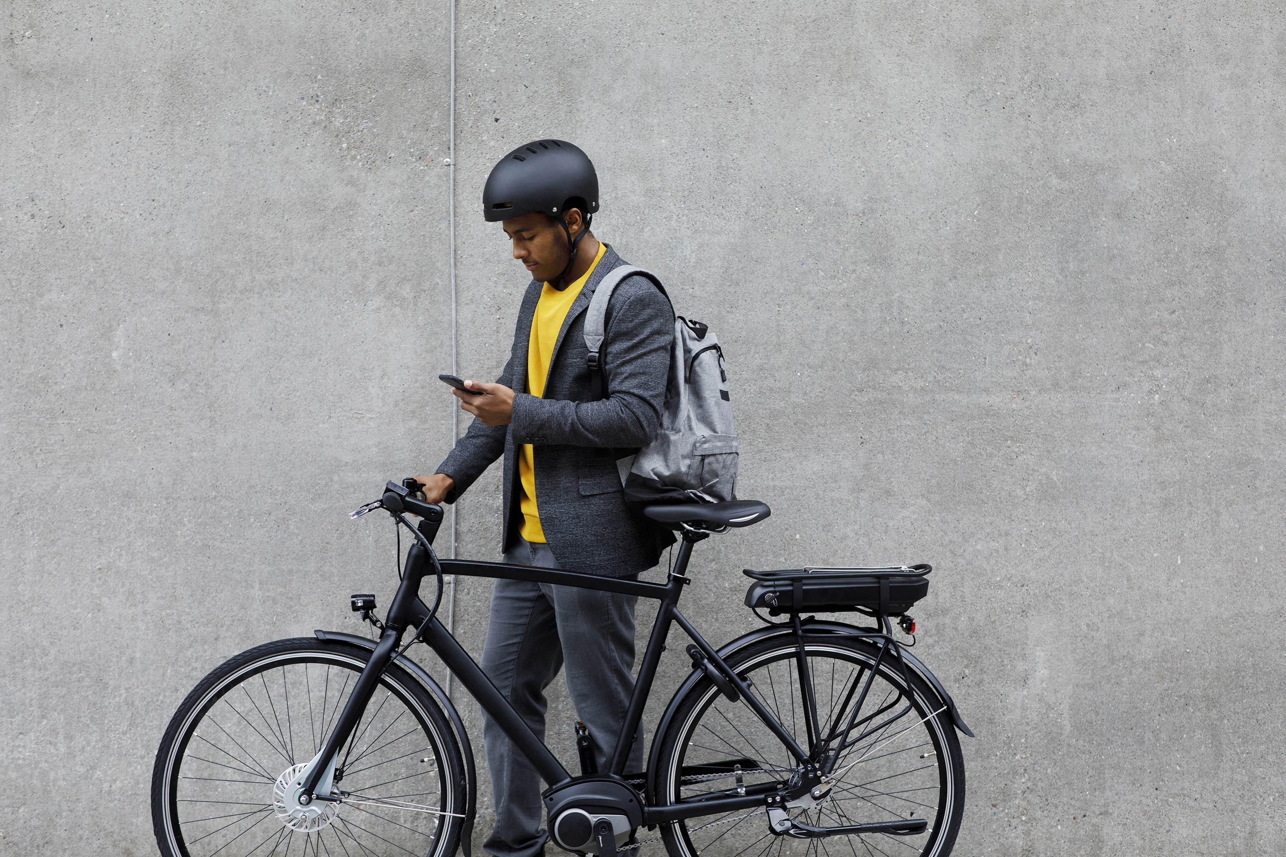
Cyclistic's Growth Strategy
Converting Casual Riders into
Annual Members Is Key to
Boosting Profitability

Slide 2
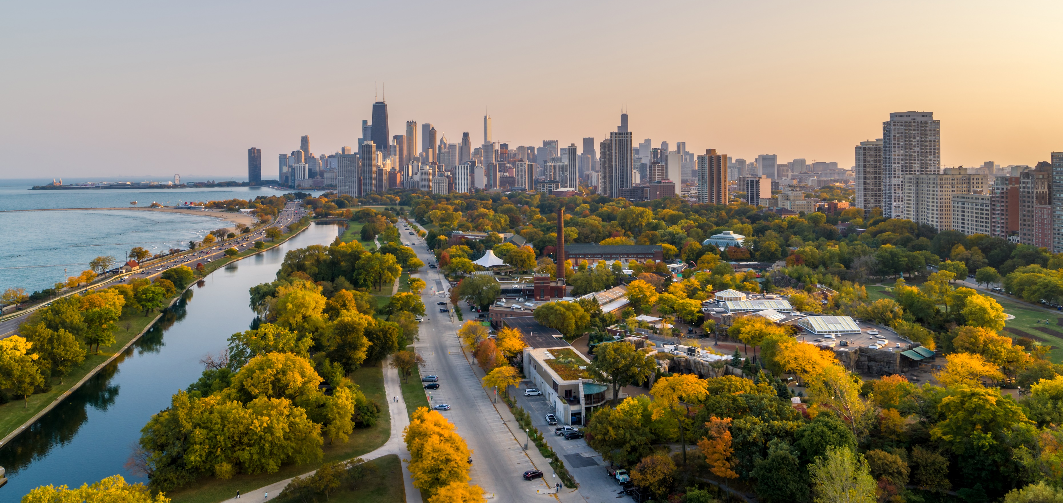

Cyclistic’s Growth Depends on
Understanding and Marketing to Casual Riders
Where are we now?
Where do we go from here?
Since our Chicago launch in 2016, Cyclistic has grown into a successful bike-share company with over 5,800 bikes and nearly 700 stations
To drive growth, Cyclistic aims to convert casual riders into more profitable annual members
We offer flexible pricing that attracts two types of riders:
Casual riders (single-ride or day passes)
Annual members (unlimited rides)
Understanding the usage patterns of both rider types is key to designing an effective marketing strategy
Notes:
Before giving presentation, change “Where do we go from here?” ANIMATION to “after click” to give time to discuss the first bullet points.

Slide 3
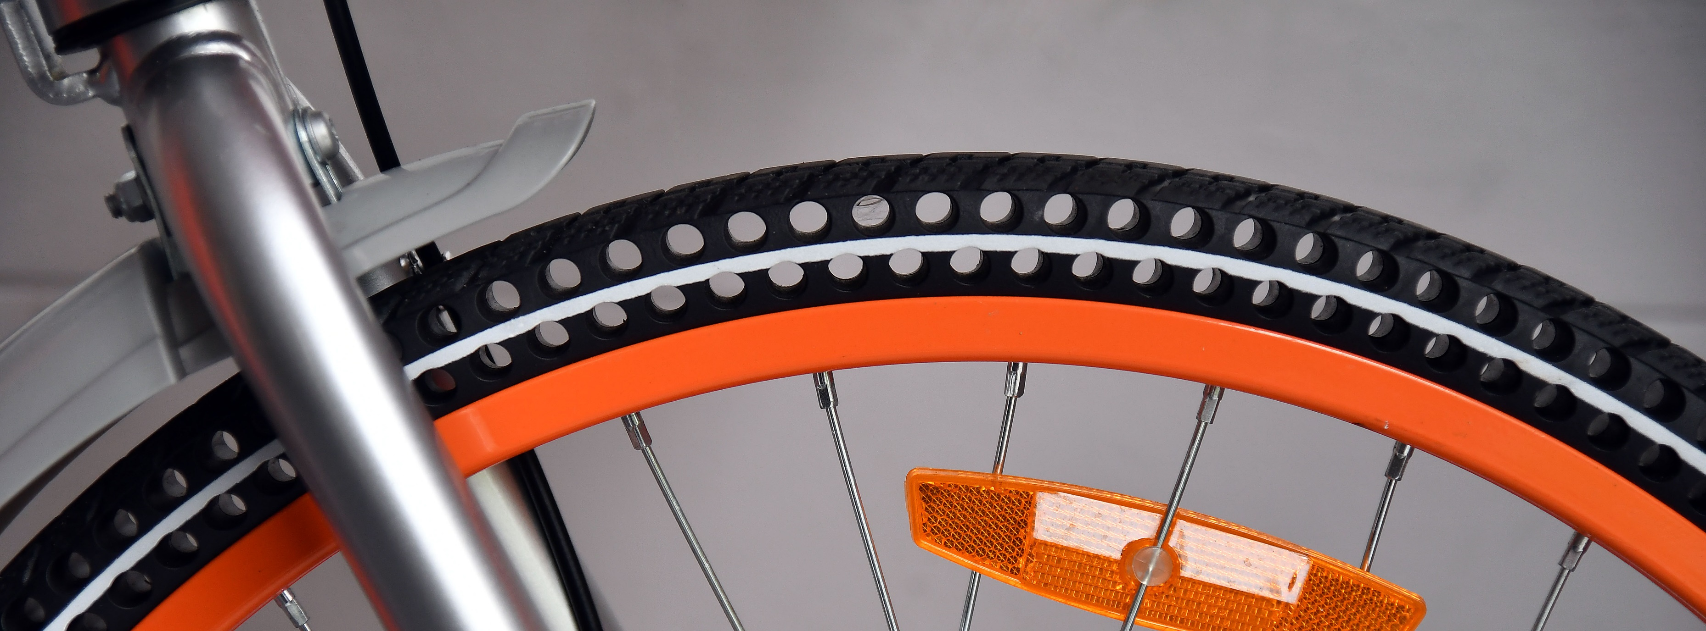
TITLE HERE
Four Key Insights
Revealed via Data Analysis
1) Worth Targeting Casual Riders?
Yes, there are plenty of casual riders to convert.
In one year, over 2 million rides were from casual riders.
2) When Launch Ad Campaigns?
Launch social media flash campaigns on Thursdays and Fridays
during the peak months of May through September.
3) Where Target Print Ads?
Target the top 50 casual rider stations,
located along Lake Michigan, with print marketing.
4) Core Message:
Appeal to Casual Riders by understanding their interests in
exploration, leisure, and evening transportation.

Slide 4
TITLE HERE
Four Key Insights
Revealed via Data Analysis
1) Worth Targeting Casual Riders?
Yes, there are plenty of casual riders to convert.
In one year, over 2 million rides were from casual riders.
2) When Launch Ad Campaigns?
Launch social media flash campaigns on Thursdays and Fridays
during the peak months of May through September.
3) Where Target Print Ads?
Target the top 50 casual rider stations,
located along Lake Michigan, with print marketing.
4) Core Message:
Appeal to Casual Riders by understanding their interests in
exploration, leisure, and evening transportation.

Slide 5

TITLE HERE
Dataset Overview:
Understanding the Data Behind Rider Behavior
About the Data
Analyzed the most recent publicly available bike-share data, covering one year from 9/1/23 to 8/31/24
~ 5.7 million rides analyzed
For privacy reasons, some columns were removed before being made public
Therefore, we just have data about the rides - not the users. There is no way to know if the riders were locals or visitors, or the number of unique users
What was Analyzed?
How many casual rides vs. annual member rides?
When do casual riders use our services?
Time of the year
Time of the day
Weekend vs. weekday
How long are the rides?
Bike choice: E-bike or classic?
Where are the most popular places to ride to / from?

Slide 6
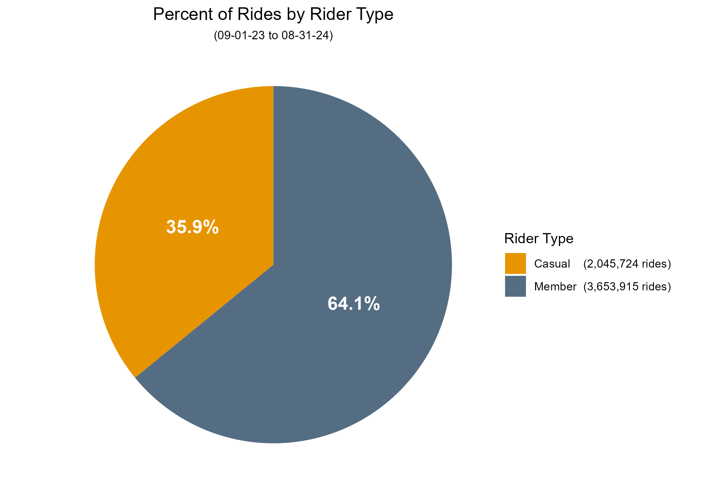
TITLE HERE
Casual Riders Represent Over 1/3 of Total Rides,
Making Them a Valuable Target Segment
35.9% of rides – over 2,045,000 – were from casual riders
Casual riders are clearly worth focusing on converting to annual members

Slide 7
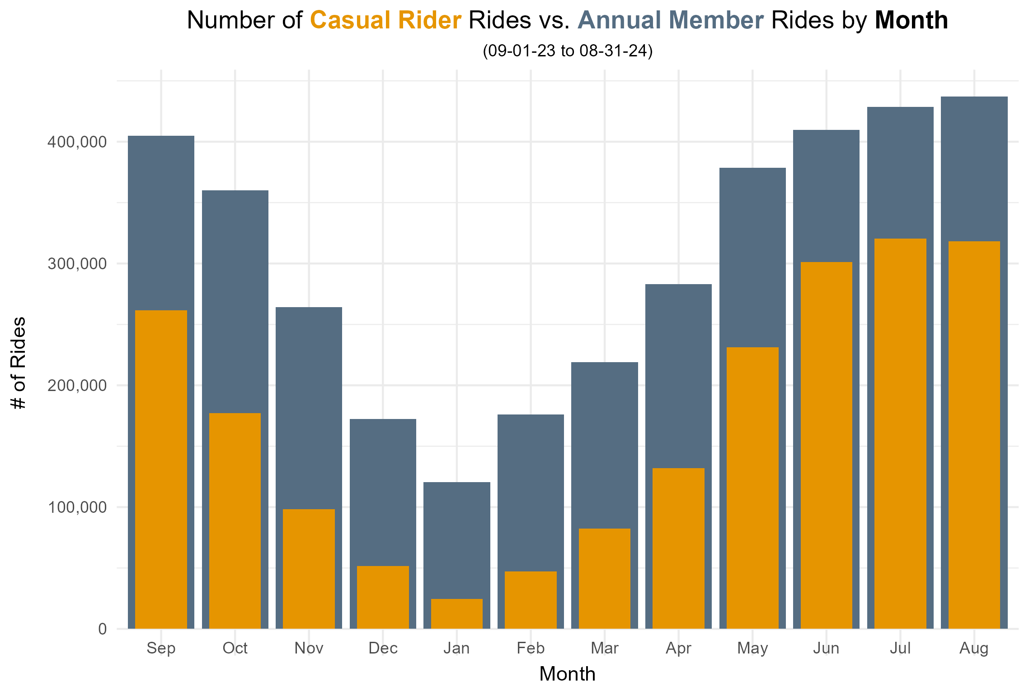
TITLE HERE
Optimal Marketing Window: May through September Shows Highest Casual Rider Engagement
May: Casual rides were 61% of members
Sept ‘23 & May-Aug ‘24
Casual rides > 50% of annual member rides
70% of all casual rides
were taken Sept ‘23 or May-Aug ’24
Focus marketing
campaigns May-Sept
Jan: Casual rides were 20% of members

Slide 8
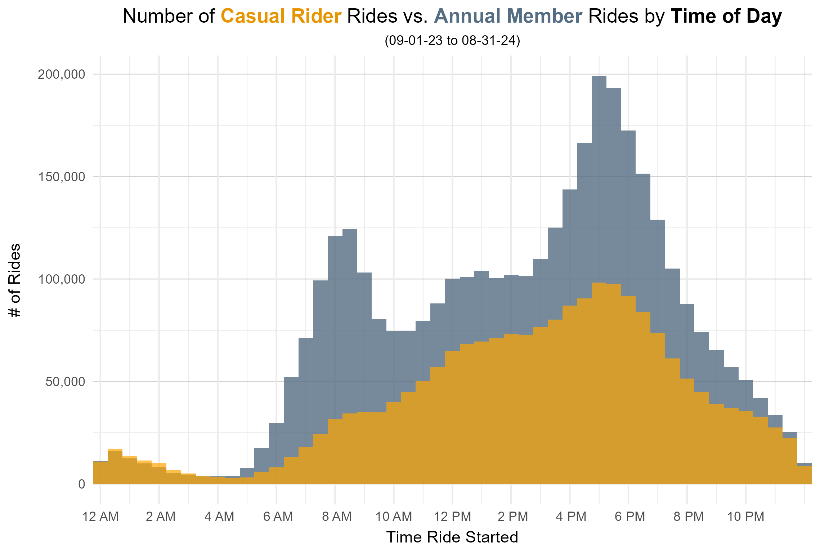
TITLE HERE
Casual Riders Lack Morning Surge Seen Among Members, Highlighting Tendency for Afternoon and Evening Rides
Casual riders have a
relatively high afternoon activity period, and peak around 5-6pm
Promote to casual
riders that our bikes are the perfect way to enjoy the afternoon & a convenient way to get to/from dinner

Slide 9
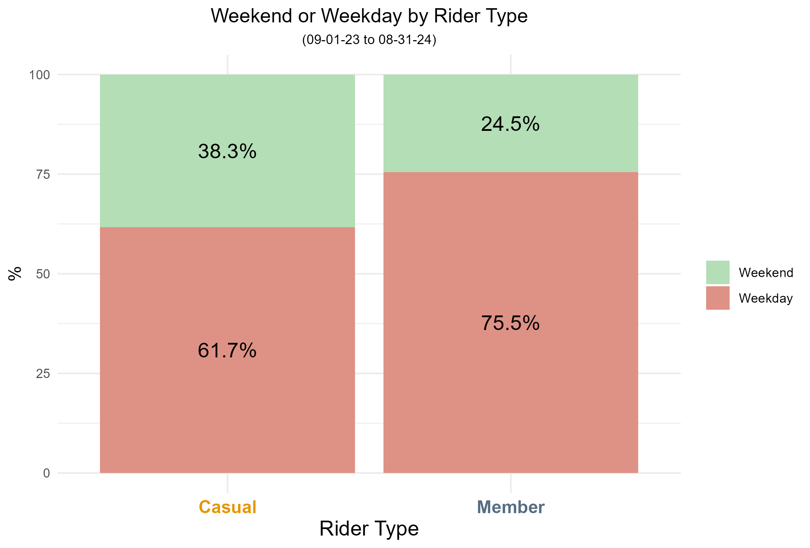
TITLE HERE
Casual Riders’ Weekend Preference Points to
Key Timing for Flash Campaigns
When compared to
members, casual riders are ~56% more likely to ride on the weekend
Run social media ad
blitzes on Thurs and Fri nights - right when casual riders are making their weekend plans
Highlight the benefits
of an annual membership for regular weekend rides
Notes:
STATISTIC: “Absolute Difference” between rider types is 13.8%, but “Relative Difference” is more relevant here: (38.3 - 24.5) / 24.5 = 56.3%

Slide 10
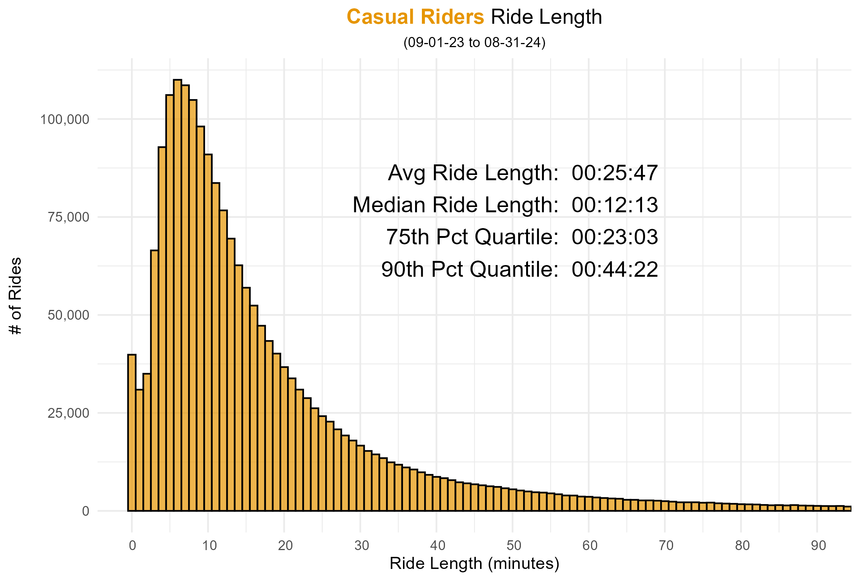
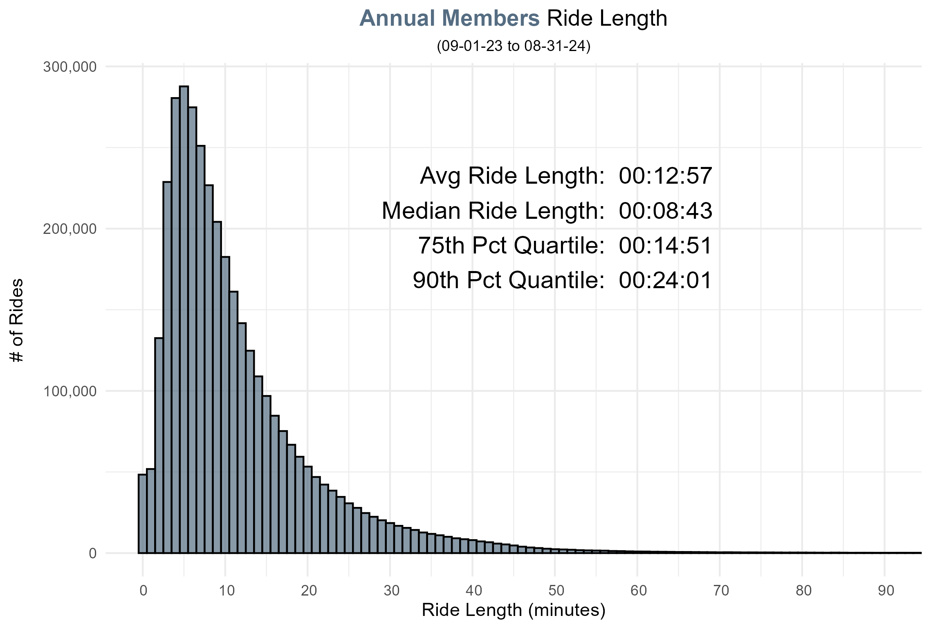
TITLE HERE
Casual Riders’ Longer Trips Point to Leisure and Exploration, Differing from Members’ Quick Commutes
Casual riders have longer average ride
length - almost twice as long!
Suggests a substantial portion of rides
are quite long (leisure, exploration, etc.)
Appeal to these riders by showcasing that “our extensive network of nearly 700 stations enables riders to discover many exciting areas throughout Chicago”

Slide 11
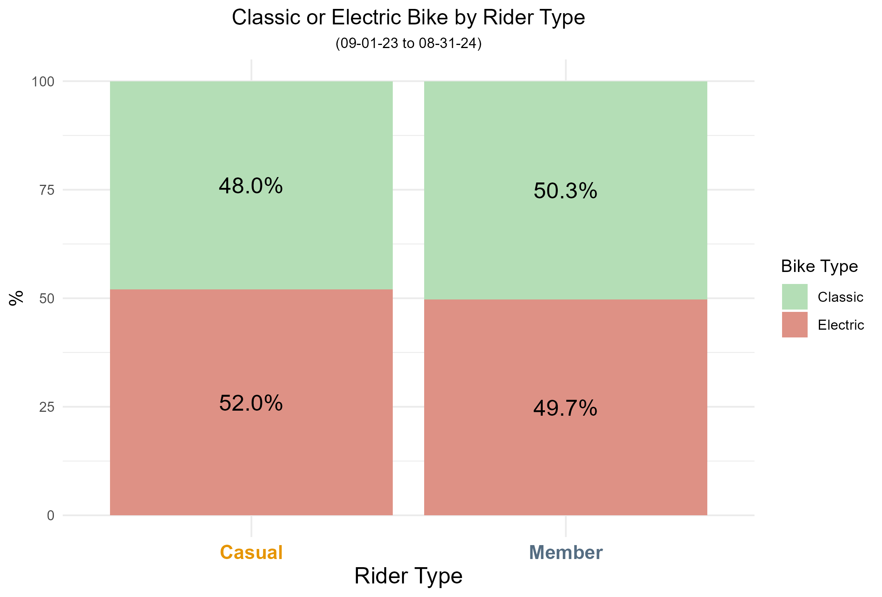
TITLE HERE
Casual Riders’ Subtle Preference for E-Bikes
Reveals Opportunity to Emphasize their Benefits
Casual riders have
small, but statistically significant preference for e-bikes.
Even only a 2.3%
difference among rider types amounts to over 45,000 additional e-bike rides per year for casual riders.
Lean into this
preference and market e-bikes as a better option for leisure & long exploratory rides.
Notes:
STATISTIC: If casual riders chose electric bikes 49.7% of the time (like the members do) there would be 2,045,724 X (2.3%) = 47,052 fewer e-bike rides.

Slide 12
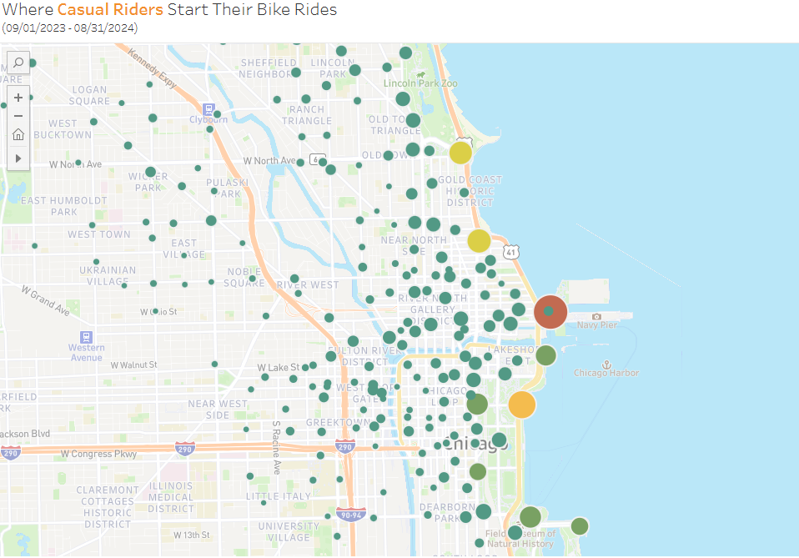
TITLE HERE
Casual Rider Activity Centers Along Lake Michigan,
from Lincoln Park to Field Museum
The busiest stations for casual riders are focused along Lake Michigan
Concentrate marketing signage at the top 50 casual rider stations.
These top 50 stations were the start or end station for casual riders over 1.1 million times.
Link to Tableau Map
Link to Top 50 Stations CSV
Notes:
STATISTIC: 1.1 Million statistic does not directly correlate to the total number of casual rider rides (2,045,724) because former is the “number of casual rider visits to each station” (start station and end station) for each ride, while the latter is the “number of casual rider rides”.

Slide 13

Questions?
For more details, please visit the project repository on GitHub here
TITLE HERE
Four Key Insights
1) Worth Targeting Casual Riders?
Yes, there are plenty of casual riders to convert
2) When Launch Ad Campaigns?
Thursdays & Fridays from May - September
3) Where Target Print Ads?
Top 50 casual rider stations
4) Core Message:
“With annual membership, casual riders gain unlimited access to nearly 700 stations for weekend adventures, e-bikes for leisurely afternoon rides, and a convenient way to enjoy the most popular lakeside restaurants - no parking required.”

Slide 14
TITLE HERE
Questions?
For more details, please visit the project repository on GitHub here
1) Worth Targeting Casual Riders?
2) When Launch Ad Campaigns?
Yes, there are plenty of casual riders to convert
3) Where Target Print Ads?
Thursdays & Fridays from May - September
4) Core Message:
Top 50 casual rider stations
“With annual membership, casual riders gain unlimited access to nearly 700 stations for weekend adventures, e-bikes for leisurely afternoon rides, and a convenient way to enjoy the most popular lakeside restaurants - no parking required.”

